Slide 1
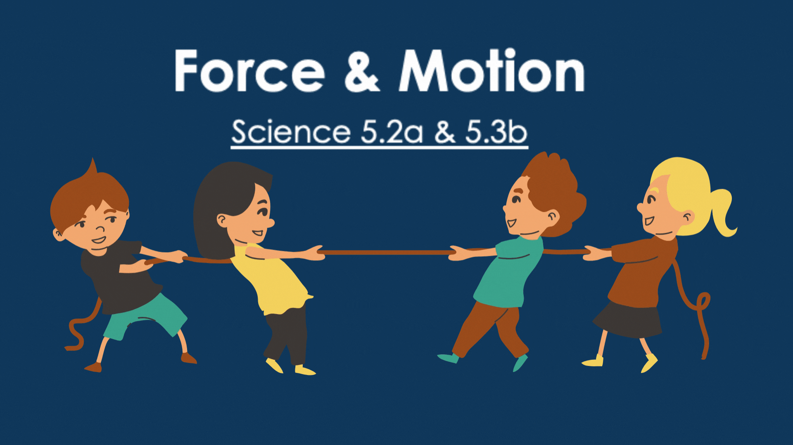

CLICK HERE TO BEGIN
Notes:
Image was altered in Canva adding the Title and Subtitle to the image and downloaded as a GIF.
Image Source: Canva
Welcome to today’s lesson on Force & motion!
Look at the tug of war game going on, Who do you think will win?
Click on the team you think will win!

Slide 2
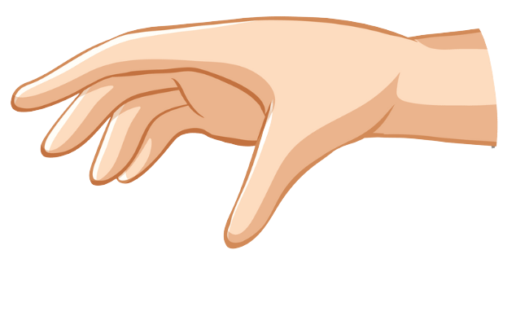


Table of Contents
Force
Motion
Push
Pull
Video
Notes:
Images are from Canva – they were edited by separating the two images, removing the background and putting them together in PowerPoint so that the ball could drop from the hand to show motion.
Image Source: Canva
Sound Source: Pixabay Sound Effects
Use the table of contents to help you learn and review about force and motion!
You can always return back here by clicking on the home button at the bottom of each screen!

Slide 3
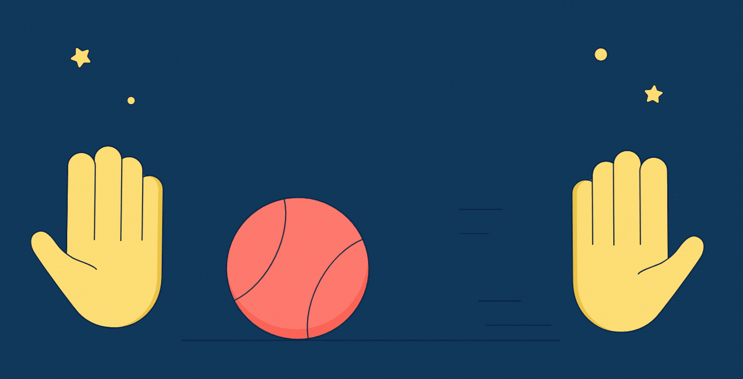
Force
A force is a push or pull in a certain direction that causes an object to move or stop moving.
Forces can change the speed or direction of an object.
apply force here
Notes:
Image Source: Canva

Slide 4




Motion
When a force is applied, an object can change its position.
The object will also change its speed and direction. This is called motion.
apply force here
Notes:
Image was edited to be broken up into 4 different motions. It was created in Canva, and then I downloaded it as a GIF for the first 3 examples. I had to trim the GIF to fit the narration and examples.
Then I had to take a screenshot of the GIF to place in to allow the block to not move when force is not applied.
Image Source: Canva
Sound Source: Pixabay Sound Effects
When the fist applies force to the block, by pushing it – the blocks motion can be described as moving forwards.
When the fist applies force to the block by pulling it – the block is changing position by moving backwards.
You can also see that when no force is applied, the block ahs no motion until a force is applied.
3.67
6.21

Slide 5
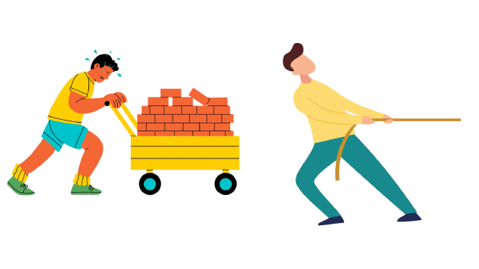
Push
Pushing is a force that is exerted to move something away from you.
This man is exerting a strong, or large, force to push the wagon of bricks because the wagon is heavy.
apply force here
Notes:
Image Source: Canva
Sound Source: Pixabay Sound Effects

Slide 6
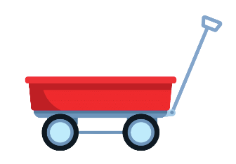

Pull
The opposite of pushing is pulling. Pulling is a force you exert to move something closer to you.
This man exerted a weak or small force to pull the teddy bear because the mass of the bear was light.
apply force here
Notes:
Image Source: Canva
Sound Source: Pixabay Sound Effects

Slide 7

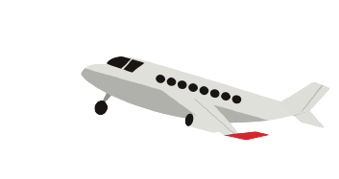

Discover Force
apply force here
Video: All About Force – Push and Pull
Notes:
Images from Canva
“DEmystified: Force.” Discovery Education, Discovery Education, 2022, https://app.discoveryeducation.com/learn/videos/36a98046-f143-4dc5-af52-7aa8e1b8fa19.
Have you ever wondered how a rocket can launch into space? Or a plane flies through the air? These motions require a force to get the moving. Let’s check out a video about force and its two forms – Push & Pull!

Slide 8
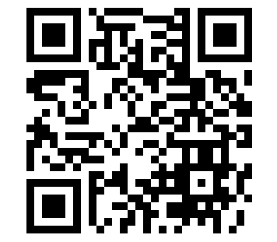
Let’s Review!
Let’s play a game to review what we have learned!
Scan the QR code using your devices camera or click the image to play the game!
apply force here
Notes:
Let’s review with a game!
Scan the QR code with your device, or click on the QR code to launch the quiz show! Good Luck!
Sound Source: Pixabay Sound Effects

Slide 9

More Information
For more information remember to check the
Fifth Grade Virtual Library.
Any questions or concerns, contact me at er596491@ucf.edu
An apple in motion.
Notes:
Image from Canva
Sound Source: Pixabay Sound Effects
I hope you enjoyed learning about force and motion. Remember that you have videos and study guides available on the fifth grade virtual library site! May the force be with you!

